Slide 1
Data Mining Unit-I: Introduction to Data Mining
Dr.G.Padmavathi Associate professor CRRAO AIMSCS

Slide 2
Course Overview
Credits: 3 (L-T-P: 3-0-0)
Pre-requisites: Database Management Systems
Probability and Statistics
Goal: Introduce key data mining techniques & their applications

Slide 3
Data Mining Syllabus
UNIT - I
Introduction to Data Mining:
What Data mining? Kinds of Data, Knowledge Discovery process, Data Mining Functionalities, Kinds of Patterns, Major Issues in Data Mining. Data Objects and Attribute Types, Basic Statistical Descriptions of Data, Data Visualization, Measuring Data Similarity and Dissimilarity, Data Pre-processing: Major Tasks in Data Pre-processing, Data Cleaning, Data Integration, Data Reduction, Data Transformation and Data Discretization.
UNIT - II
Association Analysis: Basic Concepts, Market Basket Analysis, Apriori Algorithm, FP-growth, From Association Analysis to Correlation Analysis, Pattern Mining in Multilevel Associations and Multidimensional Associations.
UNIT - III
Classification: Basic Concepts, Decision Tree Induction, Bayes Classification Methods, Rule-Based Classification, Metrics for Evaluating Classifier Performance, Ensemble Methods, Multilayer Feed- Forward Neural Network, Support Vector Machines, k-Nearest-Neighbor Classifiers.
UNIT - IV
Cluster Analysis: Requirements for Cluster Analysis, Overview of Basic Clustering Methods, Partitioning Methods-k-Means, k-Medoids, Hierarchical Methods-AGENES, DIANA, BIRCH, Density- Based Method-DBSCAN, Outlier Analysis: Types of Outliers, Challenges of Outlier Detection, and Overview of Outlier Detection Methods
UNIT - V
Advanced Concepts: Web Mining- Web Content Mining, Web Structure Mining, Web Usage Mining, Spatial Mining- Spatial Data Overview, Spatial Data Mining Primitives, Spatial Rules, Spatial Classification Algorithm, Spatial Clustering Algorithms, Temporal Mining- Modeling Temporal Events, Time Series, Pattern Detection, Sequences, Temporal Association Rules.

Slide 4
TEXT BOOKS:
Jiawei Han, Micheline Kamber, Jian Pei., Data Mining: Concepts and Techniques, 3rd Edition, Morgan Kaufmann/Elsevier, 2012.
Margaret H Dunham, Data Mining Introductory and Advanced Topics, 2nd Edition, Pearson Education, India, 2006.
REFERENCE BOOKS:
Data Mining Techniques, Arun K Pujari, 3rd Edition, Universities Press.
Pang-Ning Tan, Michael Steinbach, Anuj Karpatne and Vipin Kumar, Introduction to Data Mining, 2nd Edition, Pearson Education India, 2021.
Amitesh Sinha, Data Warehousing, Thomson Learning, India, 2007.

Slide 5
UNIT - I Introduction to Data Mining
What Data mining?
Kinds of Data,
Knowledge Discovery process,
Data Mining Functionalities,
Kinds of Patterns,
Major Issues in Data Mining.
Data Pre-processing:
Major Tasks in Data Pre-processing,
Data Cleaning,
Data Integration,
Data Reduction,
Data Transformation and Data Discretization.
Data Objects and Attribute Types
Basic Statistical Descriptions of Data,
Data Visualization,
Measuring Data Similarity and Dissimilarity,

Slide 6
Unit I: Introductionto Data Mining
Data mining definitions, goals, and processes
Types of data, patterns, and issues
Data visualization, similarity measures
Data cleaning, integration, transformation

Slide 7
Chapter 3 in Prescribed textbook
Data Preprocessing
Data Preprocessing: An Overview
Data Quality: Why Preprocess the Data?
Major Tasks in Data Preprocessing
Data Cleaning
Missing Values
Noisy Data
Data Cleaning as a Process
Data Integration
Entity Identification Problem
Redundancy and Correlation Analysis
Tuple Duplication
Data Value Conflict Detection and Resolution
Data Reduction
Overview of Data Reduction Strategies
Wavelet Transforms
Principal Components Analysis
Attribute Subset Selection
Regression and Log-Linear Models: Parametric Data Reduction
Histograms
Clustering
Sampling
Data Cube Aggregation
Data Transformation and Data Discretization
Data Transformation Strategies Overview
Data Transformation by Normalization
Discretization by Binning
Discretization by Histogram Analysis
Discretization by Cluster, Decision Tree, and Correlation Analyses
Concept Hierarchy Generation for Nominal Data

Slide 8
Data Quality: Why Preprocess the Data?
Measures for data quality: A multidimensional view
Accuracy: correct or wrong, accurate or not
Completeness: not recorded, unavailable, …
Consistency: some modified but some not, dangling, …
Timeliness: timely update?
Believability: how trustable the data are correct?
Interpretability: how easily the data can be understood?

Slide 9
Major Tasks in Data Preprocessing
Data cleaning
Fill in missing values, smooth noisy data, identify or remove outliers, and resolve inconsistencies
Data integration
Integration of multiple databases, data cubes, or files
Data reduction
Dimensionality reduction
Numerosity reduction
Data compression
Data transformation and data discretization
Normalization
Concept hierarchy generation

Slide 10
Data Cleaning
Data in the Real World Is Dirty: Lots of potentially incorrect data, e.g., instrument faulty, human or computer error, transmission error
incomplete: lacking attribute values, lacking certain attributes of interest, or containing only aggregate data
e.g., Occupation=“ ” (missing data)
noisy: containing noise, errors, or outliers
e.g., Salary=“−10” (an error)
inconsistent: containing discrepancies in codes or names, e.g.,
Age=“42”, Birthday=“03/07/2010”
Was rating “1, 2, 3”, now rating “A, B, C”
discrepancy between duplicate records
Intentional (e.g., disguised missing data)
Jan. 1 as everyone’s birthday?

Slide 11
Incomplete (Missing) Data
Data is not always available
E.g., many tuples have no recorded value for several attributes, such as customer income in sales data
Missing data may be due to
equipment malfunction
inconsistent with other recorded data and thus deleted
data not entered due to misunderstanding
certain data may not be considered important at the time of entry
not register history or changes of the data
Missing data may need to be inferred

Slide 12
How to Handle Missing Data?
Ignore the tuple: usually done when class label is missing (when doing classification)—not effective when the % of missing values per attribute varies considerably
Fill in the missing value manually: tedious + infeasible?
Fill in it automatically with
a global constant : e.g., “unknown”, a new class?!
the attribute mean
the attribute mean for all samples belonging to the same class: smarter
the most probable value: inference-based such as Bayesian formula or decision tree

Slide 13
Noisy Data
Noise: random error or variance in a measured variable
Incorrect attribute values may be due to
faulty data collection instruments
data entry problems
data transmission problems
technology limitation
inconsistency in naming convention
Other data problems which require data cleaning
duplicate records
incomplete data
inconsistent data
Notes:
13

Slide 14
How to Handle Noisy Data?
Binning
first sort data and partition into (equal-frequency) bins
then one can smooth by bin means, smooth by bin median, smooth by bin boundaries, etc.
Regression
smooth by fitting the data into regression functions
Clustering
detect and remove outliers
Combined computer and human inspection
detect suspicious values and check by human (e.g., deal with possible outliers)

Slide 15
Data Cleaning as a Process
Data discrepancy detection
Use metadata (e.g., domain, range, dependency, distribution)
Check field overloading
Check uniqueness rule, consecutive rule and null rule
Use commercial tools
Data scrubbing: use simple domain knowledge (e.g., postal code, spell-check) to detect errors and make corrections
Data auditing: by analyzing data to discover rules and relationship to detect violators (e.g., correlation and clustering to find outliers)
Data migration and integration
Data migration tools: allow transformations to be specified
ETL (Extraction/Transformation/Loading) tools: allow users to specify transformations through a graphical user interface
Integration of the two processes
Iterative and interactive (e.g., Potter’s Wheels)

Slide 16
Data Analysis
Formulate your question(sharp questions)
Read in your data (messy or clear)
Check the packaging(rows, columns, observations..)
Look at the top and the bottom of your data(what to accept and what not to accept)
Check your "n"s (identify some landmarks that can be used to check against your data. Suppose n=1000 but there are n=30)
Validate with at least one external data source
Make a plot(visualize your data )
Try the easy solution first(primary then secondary model))
Follow up(Do you have the right data? ,Do you need other data? ,Do you have the right question? )

Slide 17
Using statistical models
The first key element of a statistical model is data reduction.
The basic idea is you want to take the original set of numbers consisting of your dataset and transform them into a smaller set of numbers.
If you originally started with 20 numbers, your model should produce a summary that is fewer than 20 numbers.
The process of data reduction typically ends up with a statistic.
statistic is any summary of the data (mean, or average, median, the standard deviation, the maximum, the minimum, and the range. )

Slide 18
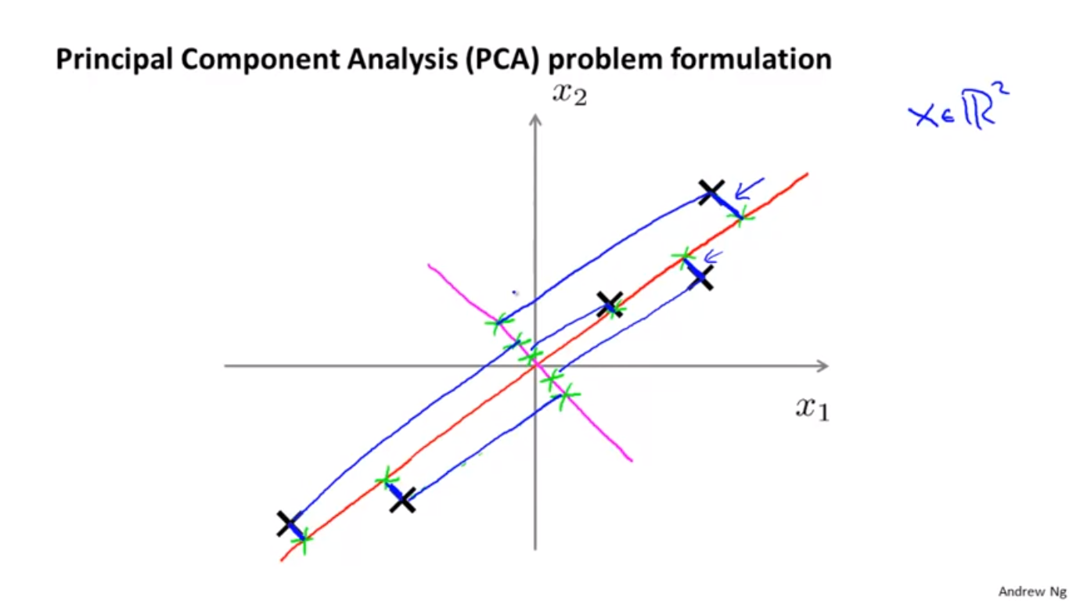
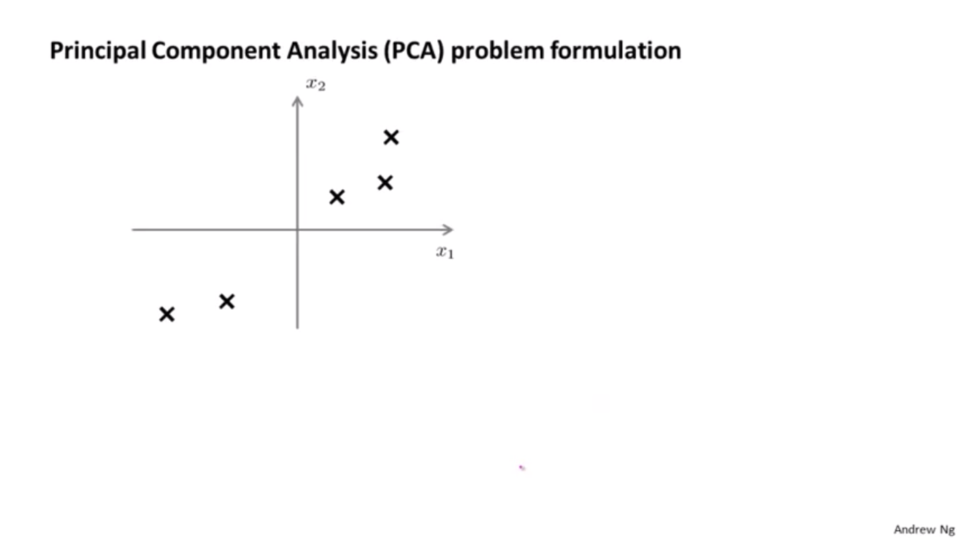
Dimension reduction
Dimension Reduction refers to the process of converting a set of data having vast dimensions into data with lesser dimensions ensuring that it conveys similar information concisely.

Slide 19
Benefits of applying Dimension Reduction process
It helps in data compressing & reducing the storage space required and fastens the time required for performing same computations.
Less dimensions leads to less computing.
It takes care of multi-collinearity that improves the model performance. It removes redundant features.
For example: there is no point in storing a value in two different units (meters and inches).
Useful for solving machine learning problems to obtain better features for a classification or regression task.

Slide 20
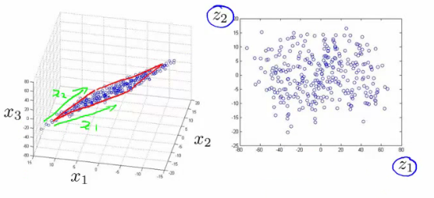
Benefits of applying Dimension Reduction process
Reducing the dimensions of data to 2D or 3D may allow us to plot and visualize it precisely.
we can then observe patterns more clearly.
From the following fig we can see that, how a 3D data is converted into 2D.
First it has identified the 2D plane then represented the points on these two new axis z1 and z2.

Slide 21
Why,What-Dimension reduction
Why Dimension Reduction is Important in machine learning and predictive modeling?Is Dimensionality Reduction good or bad?
What are the common methods to reduce number of Dimensions?

Slide 22
Why Dimension Reduction is Important in machine learning and predictive modeling?Is Dimensionality Reduction good or bad?
Motorbike rider in racing competitions:
Motorbike rider position and movement gets measured by
GPS sensor on bike,
gyro meters,
multiple video feeds
his smart watch.

Slide 23
Now assume that an analyst sits with all this data to analyze the racing strategy of the biker –would have a lot of variables / dimensions which are similar and of little (or no) incremental value.
This is the problem of high unwanted dimensions and needs a treatment of dimension reduction.

Slide 24
Example 1: You are building a regression with 10 variables, some of them are mildly correlated.
In this case, there is no need to perform any dimensionality reduction. Since there is little correlation among the variables, all of them are bringing in new information. You should keep all the variables in the mix and build a model.

Slide 25
Example 2: Again, you are building a regression model. This time with 20 variables and some of these variables would be highly correlated. For example, in case of telecom - number of calls made by a customer in a month and the monthly bill he / she receives. Or in case of insurance, it could be number of policies and total premium sold by an agent / branch.
In these cases, because you only have limited number of variables you should only add one of these variables to your model.
You can still do away with applying any formal dimensional reduction technique in this case (even though you are doing it for all practical reasons).

Slide 26
Example 3: Now assume that you have 500 such variables with some of them being correlated with each other.
For example, data output of sensors from a smartphone.
In a lot of scenarios like this, you will also see that you will retain more than 90% of information with less that 15 - 20% of variables.
Hence, these can be good applications of dimensionality reduction.

Slide 27
What are Dimension Reduction techniques?
Missing Values
Low Variance
High Correlation filter
Random Forest
Backward Feature Elimination
Forward Feature Selection
Principal Component Analysis

Slide 28
Missing Values
What if we have too many missing values (say more than 50%)?
Should we impute(assign) the missing values or drop the variable?
we can prefer to drop the variable since it will not have much information.
OR
We can set a threshold value and if the percentage of missing values in any variable is more than that threshold, we will drop the variable.

Slide 29
Data Analysis with python
Scientific Computing Libraries in Python (SCL) | Pandas(Data Structures and Tools)
 | Numpy (Arrays and Matrices)
 | Scipy (stats, Integrals, solving differential equations, optimization, etc )
Visualization Libraries in Python | Matplot lib(Plots and graphs-most popular ones)
 | Seaborn (plots like heat maps, time series, violin plots)
Algorithmic Libraries in Python | Scikit-learn (Machine Learning-regression, classification..)
 | Statsmodels (Explore data, perform statistical tests)

Slide 30
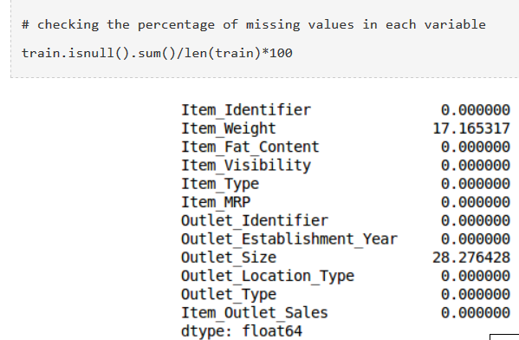
Example

Slide 31
We can impute the values using appropriate methods,
or
we can set a threshold of, say 20%, and remove the variable having more than 20% missing values.
So we can drop Outlet_size

Slide 32
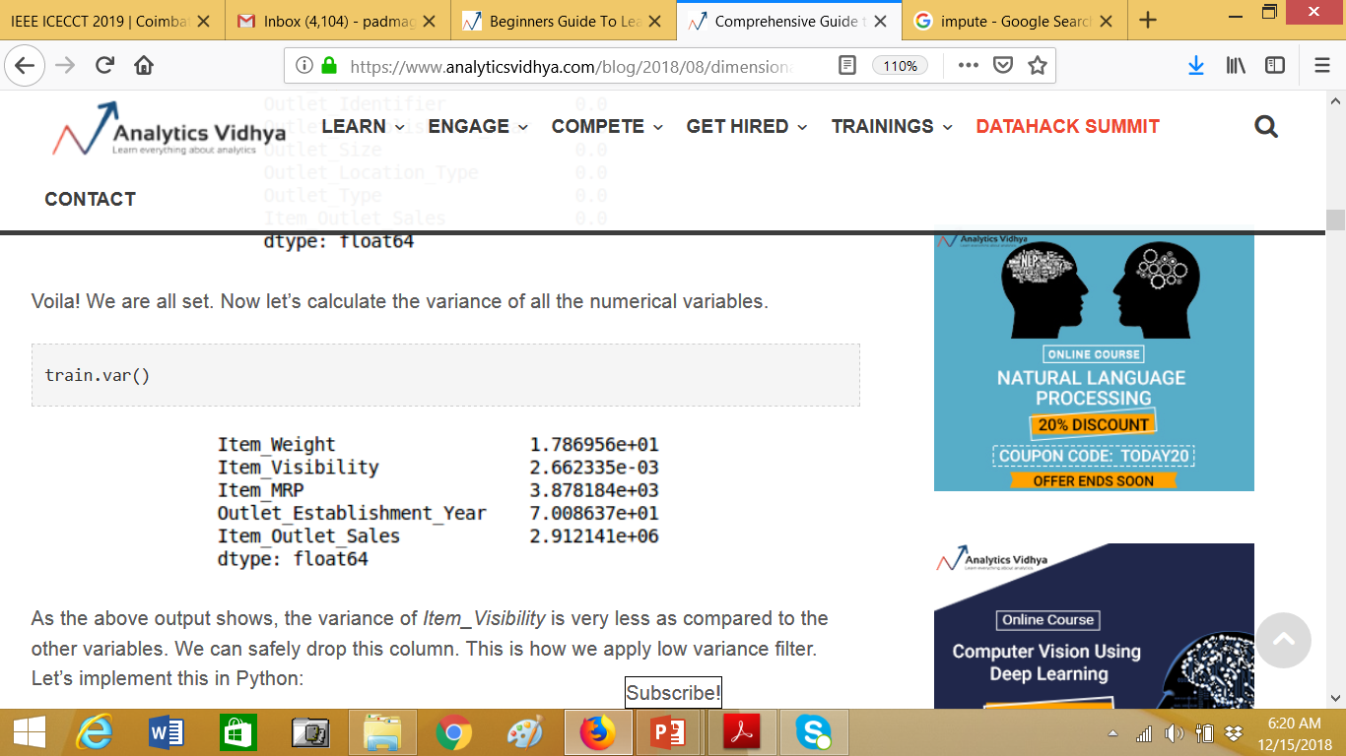
Low Variance
calculate the variance of all the numerical variables in the given data.
Then drop the variables having low variance as compared to other variables in our dataset.
From below data, we can observe the variance of Item_Visibility is very less as compared to the other variables. We can safely drop this column.

Slide 33
High Correlation filter
High correlation between two variables means they have similar trends and are likely to carry similar information.
We can calculate the correlation between independent numerical variables that are numerical in nature.
If the correlation coefficient crosses a certain threshold value, we can drop one of the variables.

Slide 34
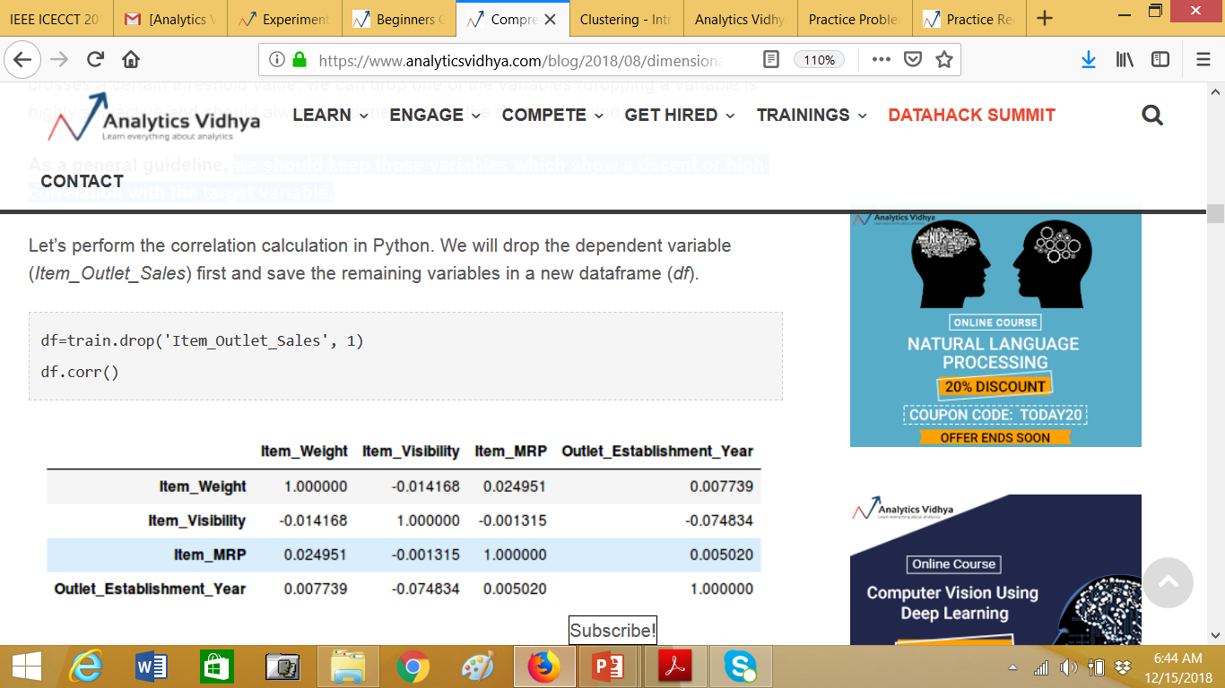
Here we don’t have any variables with a high correlation(pair of variables is greater than 0.5-0.6) in our dataset.

Slide 35
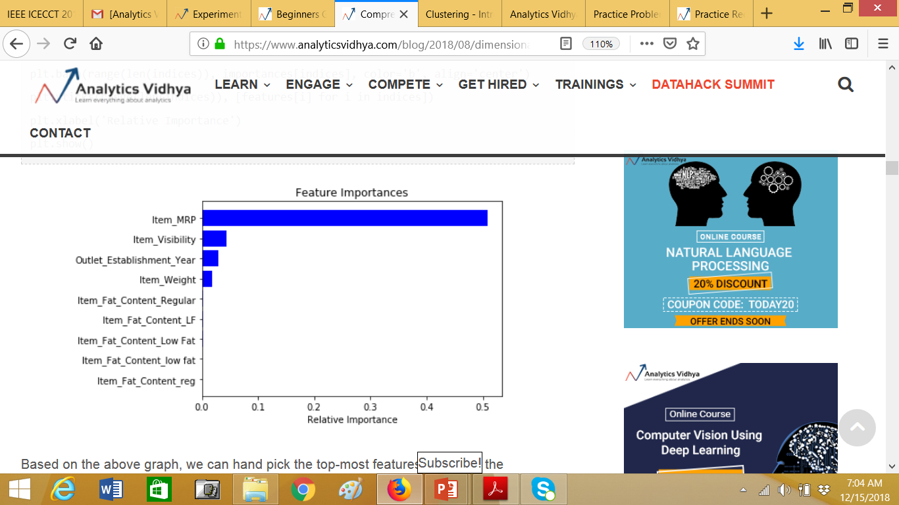
Random Forest
We need to convert the data into numeric form by applying one hot encoding, as Random Forest (Scikit-Learn Implementation) takes only numeric inputs.

Slide 36
Random Forest
we can hand pick the top-most features to reduce the dimensionality in our dataset.
we can use the SelectFromModel of sklearn to do so. It selects the features based on the importance of their weights.

Slide 37
Data Pre-processing(continued ……)
Dimensionality reduction, Data modeling

Slide 38
Backward Feature Elimination
We first take all the n variables present in our dataset and train the model using them.
We then calculate the performance of the model.
Now, we compute the performance of the model after eliminating each variable (n times), i.e., we drop one variable every time and train the model on the remaining n-1 variables.
We identify the variable whose removal has produced the smallest (or no) change in the performance of the model, and then drop that variable
Repeat this process until no variable can be dropped.
This method can be used when building Linear Regression or Logistic Regression models.

Slide 39
Forward Feature Selection
We start with a single feature. Essentially, we train the model n number of times using each feature separately
The variable giving the best performance is selected as the starting variable
Then we repeat this process and add one variable at a time. The variable that produces the highest increase in performance is retained
We repeat this process until no significant improvement is seen in the model’s performance.
NOTE : Both Backward Feature Elimination and Forward Feature Selection are time consuming and computationally expensive.

Slide 40
Factor Analysis
In the Factor Analysis technique, variables are grouped by their correlations, i.e., all variables in a particular group will have a high correlation among themselves, but a low correlation with variables of other group(s).
Here, each group is known as a factor.
These factors are small in number as compared to the original dimensions of the data. However, these factors are difficult to observe.

Slide 41
Principal Component Analysis
Principal Component Analysis (PCA) is a method of extracting important variables (in form of components) from a large set of variables available in a data set.
PCA is more useful when dealing with 3 or higher dimensional data.
It is always performed on a symmetric correlation or covariance matrix. This means the matrix should be numeric and have standardized data.

Slide 42
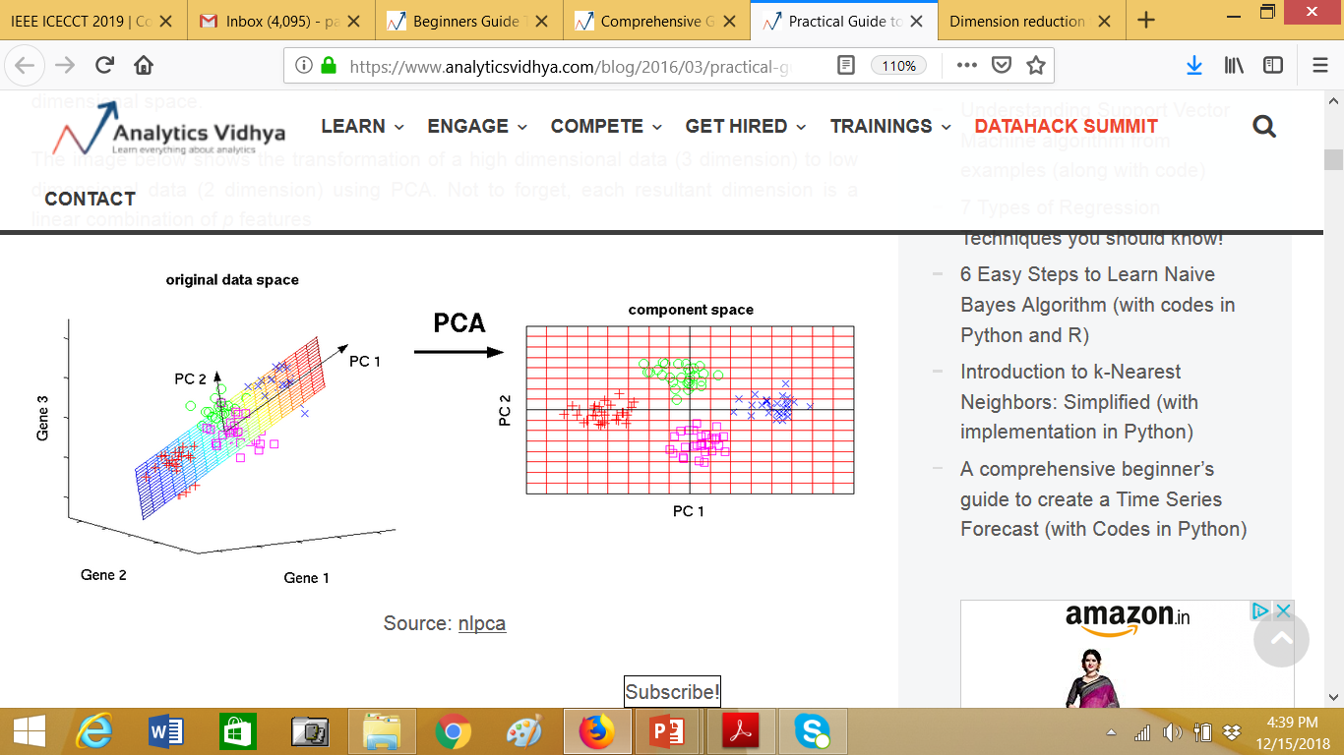
The image below shows the transformation of a high dimensional data (3 dimension) to low dimensional data (2 dimension) using PCA. Not to forget, each resultant dimension is a linear combination of p (here p=3) features.

Slide 43
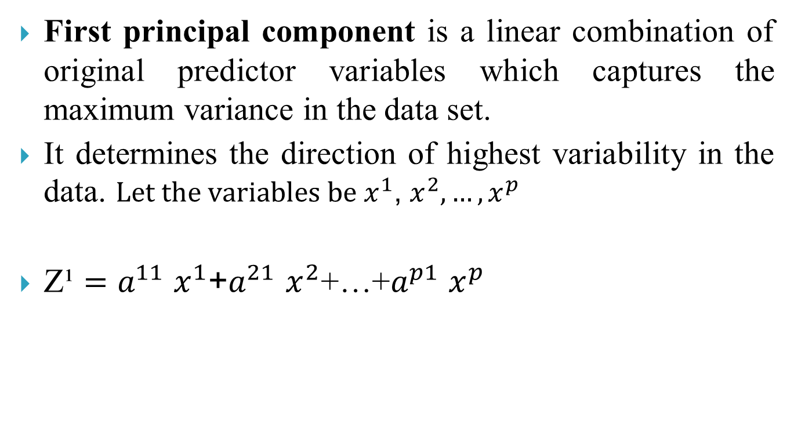
PC1
First principal component is a linear combination of original predictor variables which captures the maximum variance in the data set.
It determines the direction of highest variability in the data.${Let the variables be x}^{1}$, $x^{2},…,x^{p}$
Z¹$=a^{11}x^{1}$+$a^{21}x^{2}$+…+$a^{p1}x^{p}$

Slide 44
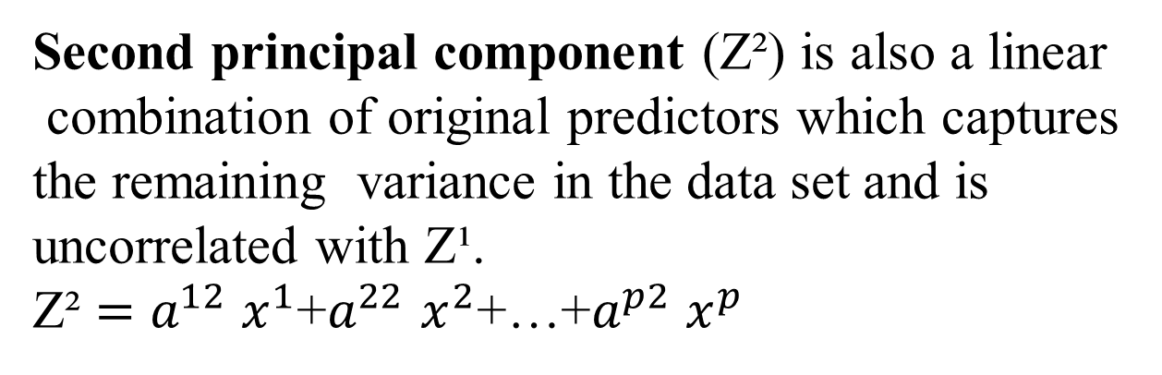
PC2
Second principal component (Z²) is also a linear
combination of original predictors which captures
the remaining variance in the data set and is
uncorrelated with Z¹.
Z² $=a^{12}x^{1}$+$a^{22}x^{2}$+…+$a^{p2}x^{p}$

Slide 45
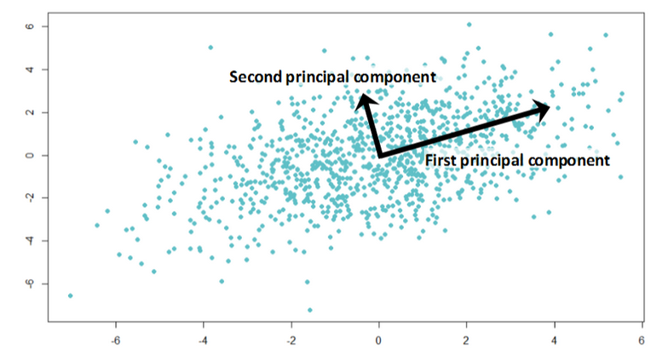
If the two components are uncorrelated, their directions should be orthogonal

Slide 46
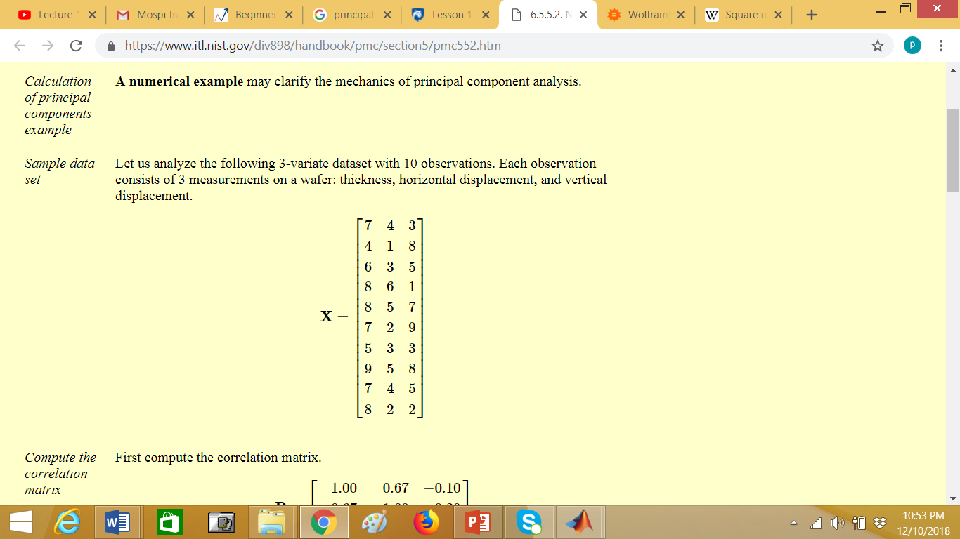

Slide 47
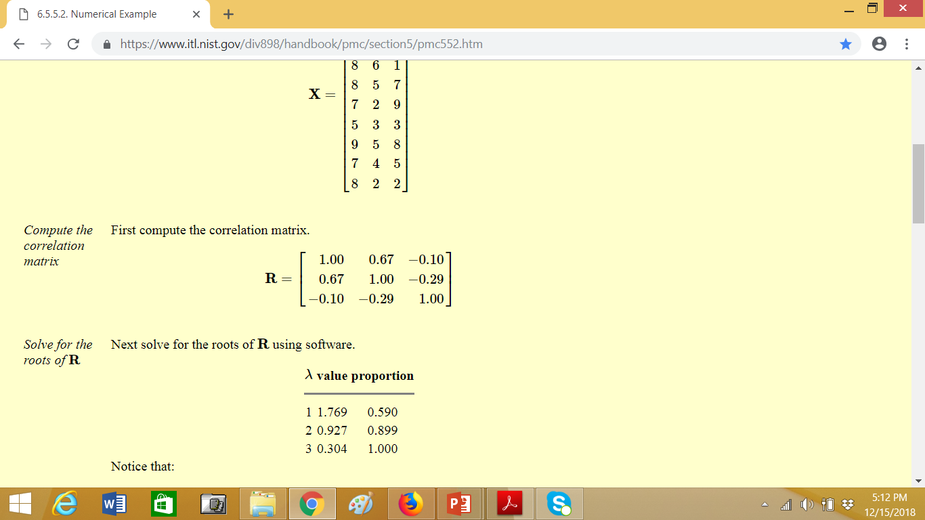
Finding eigenvalues of Correlation matrix R

Slide 48
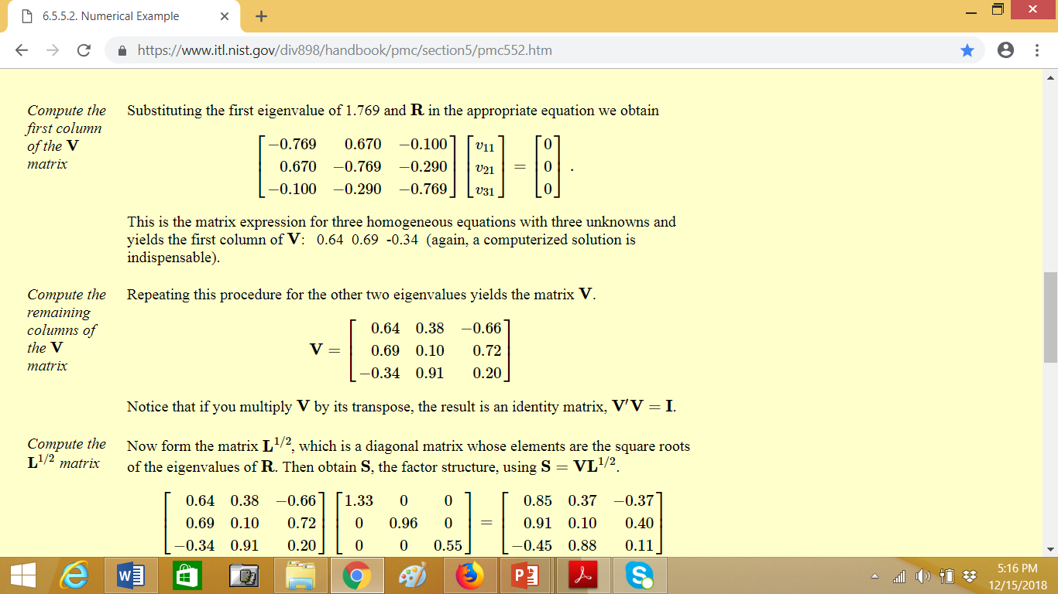

Slide 49
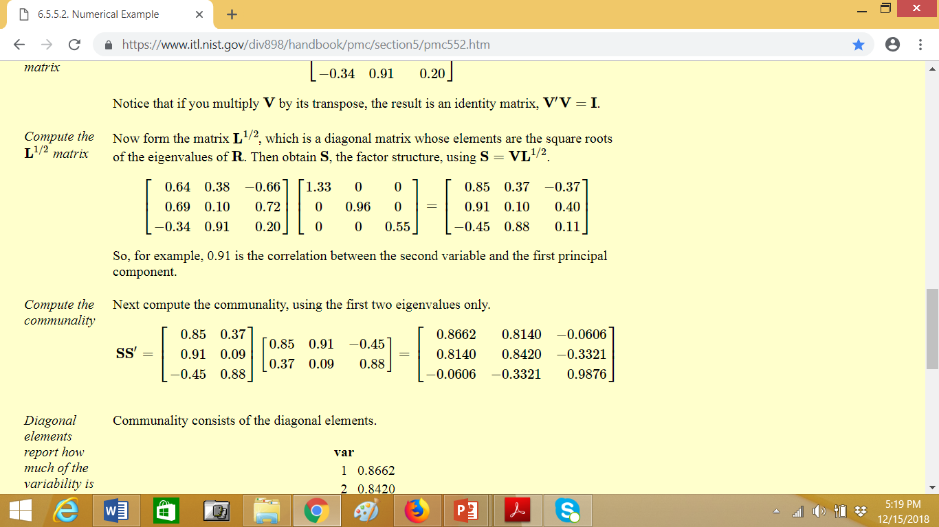

Slide 50
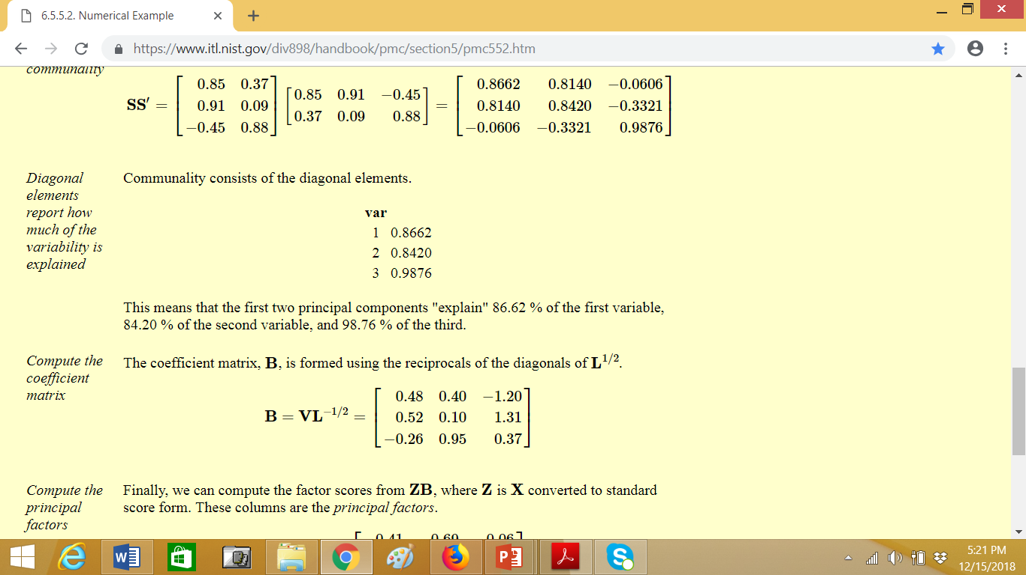

Slide 51
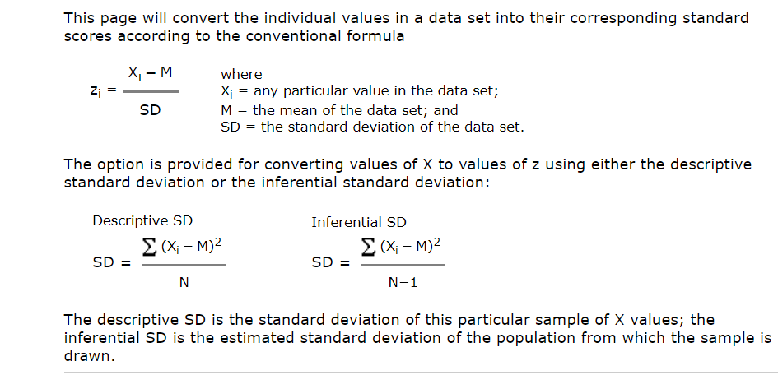
Converting to standard score

Slide 52
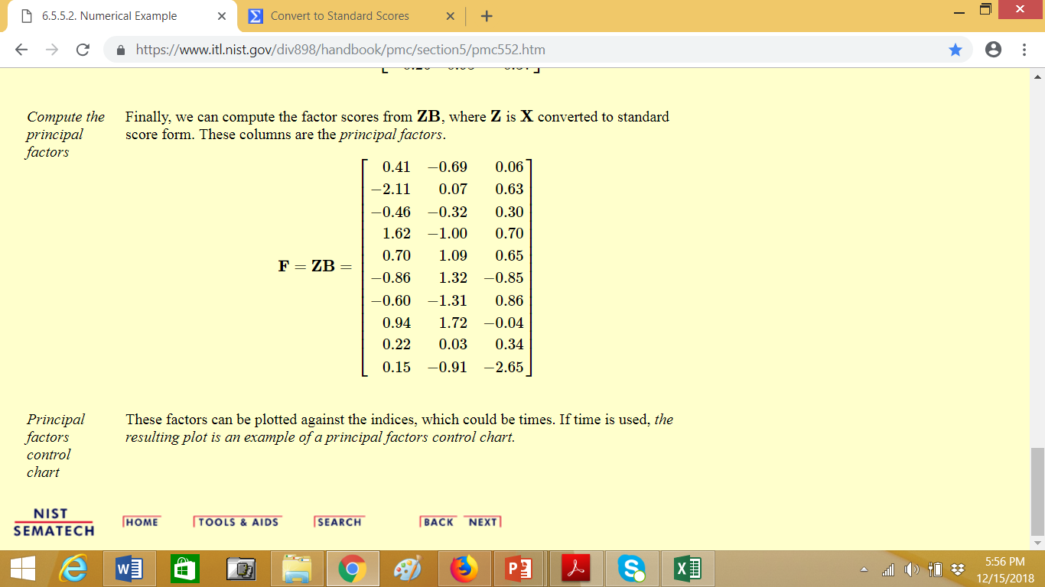

Slide 53
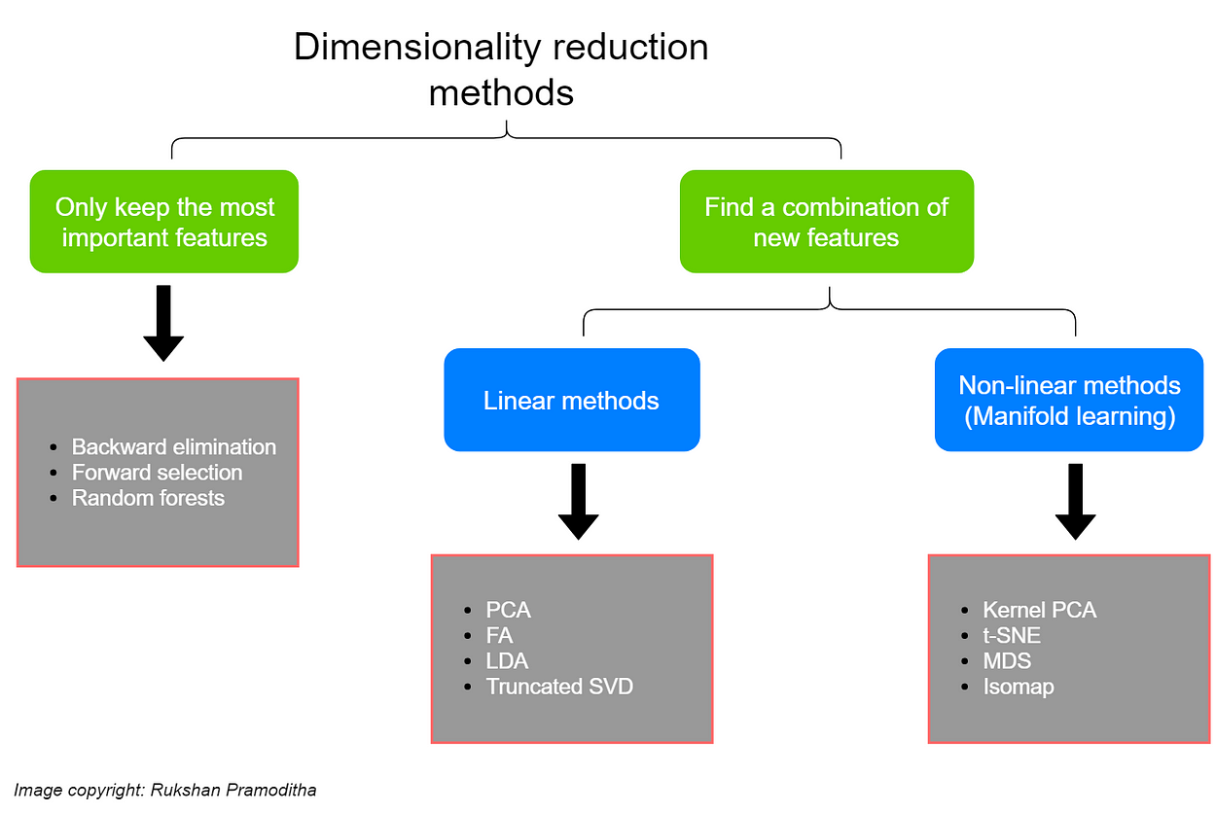

Slide 54
Data Transformation
A function that maps the entire set of values of a given attribute to a new set of replacement values s.t. each old value can be identified with one of the new values
Methods
Smoothing: Remove noise from data
Attribute/feature construction
New attributes constructed from the given ones
Aggregation: Summarization, data cube construction
Normalization: Scaled to fall within a smaller, specified range
min-max normalization
z-score normalization
normalization by decimal scaling
Discretization: Concept hierarchy climbing
Notes:
54

Slide 55
Normalization
Min-max normalization: to [new_min_{A}, new_max_{A}]
Ex. Let income range $12,000 to $98,000 normalized to [0.0, 1.0]. Then $73,000 is mapped to
Z-score normalization (μ: mean, σ: standard deviation):
Ex. Let μ = 54,000, σ = 16,000. Then
Normalization by decimal scaling
Where j is the smallest integer such that Max(|ν’|) < 1

Slide 56
Discretization
Three types of attributes
Nominal—values from an unordered set, e.g., color, profession
Ordinal—values from an ordered set, e.g., military or academic rank
Numeric—real numbers, e.g., integer or real numbers
Discretization: Divide the range of a continuous attribute into intervals
Interval labels can then be used to replace actual data values
Reduce data size by discretization
Supervised vs. unsupervised
Split (top-down) vs. merge (bottom-up)
Discretization can be performed recursively on an attribute
Prepare for further analysis, e.g., classification

Slide 57
Data Discretization Methods
Typical methods: All the methods can be applied recursively
Binning
Top-down split, unsupervised
Histogram analysis
Top-down split, unsupervised
Clustering analysis (unsupervised, top-down split or bottom-up merge)
Decision-tree analysis (supervised, top-down split)
Correlation (e.g., χ²) analysis (unsupervised, bottom-up merge)
https://medium.com/codex/data-discretization-b5faa2b77f06
57
Notes:
57

Slide 58
Simple Discretization: Binning
Equal-width (distance) partitioning
Divides the range into N intervals of equal size: uniform grid
if A and B are the lowest and highest values of the attribute, the width of intervals will be: W = (B –A)/N.
The most straightforward, but outliers may dominate presentation
Skewed data is not handled well
Equal-depth (frequency) partitioning
Divides the range into N intervals, each containing approximately same number of samples
Good data scaling
Managing categorical attributes can be tricky

Slide 59
Binning Methods for Data Smoothing
Sorted data for price (in dollars): 4, 8, 9, 15, 21, 21, 24, 25, 26, 28, 29, 34
* Partition into equal-frequency (equi-depth) bins:
- Bin 1: 4, 8, 9, 15
- Bin 2: 21, 21, 24, 25
- Bin 3: 26, 28, 29, 34
* Smoothing by bin means:
- Bin 1: 9, 9, 9, 9
- Bin 2: 23, 23, 23, 23
- Bin 3: 29, 29, 29, 29
* Smoothing by bin boundaries:
- Bin 1: 4, 4, 4, 15
- Bin 2: 21, 21, 25, 25
- Bin 3: 26, 26, 26, 34

Slide 60
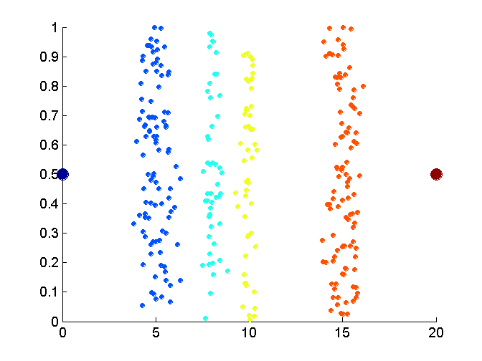
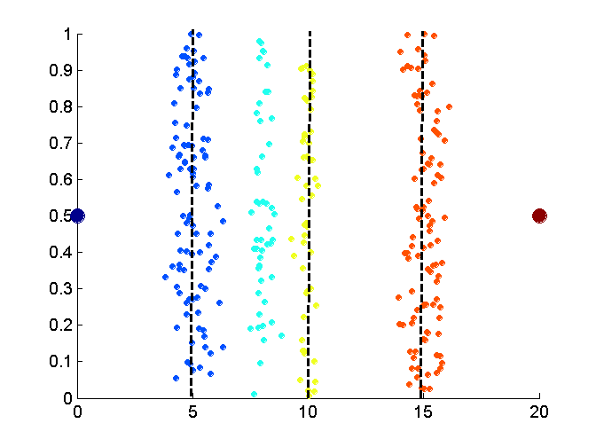
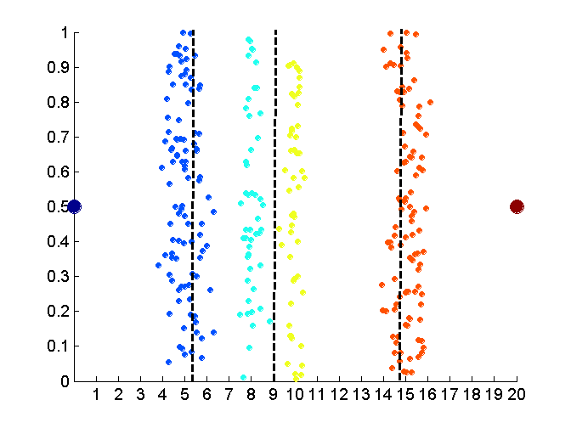
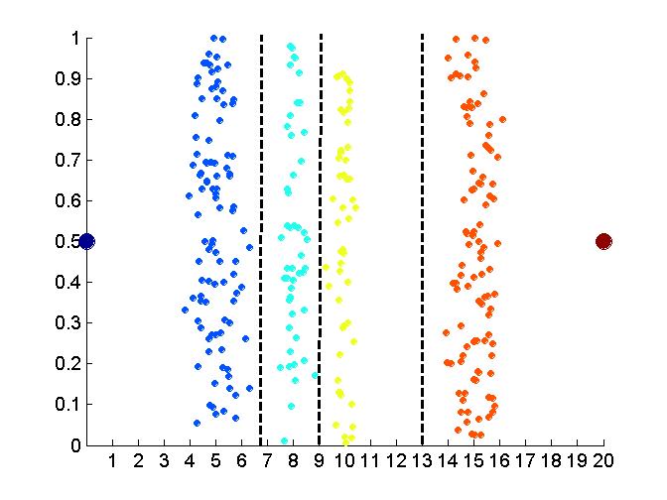
Discretization Without Using Class Labels (Binning vs. Clustering)
Data
Equal interval width (binning)
Equal frequency (binning)
K-means clustering leads to better results
60
Notes:
60

Slide 61
Discretization by Classification & Correlation Analysis
Classification (e.g., decision tree analysis)
Supervised: Given class labels, e.g., cancerous vs. benign
Using entropy to determine split point (discretization point)
Top-down, recursive split
Details to be covered in Chapter 7
Correlation analysis (e.g., Chi-merge: χ²-based discretization)
Supervised: use class information
Bottom-up merge: find the best neighboring intervals (those having similar distributions of classes, i.e., low χ² values) to merge
Merge performed recursively, until a predefined stopping condition
61
Notes:
61

Slide 62
THANK YOU

